Slide 1
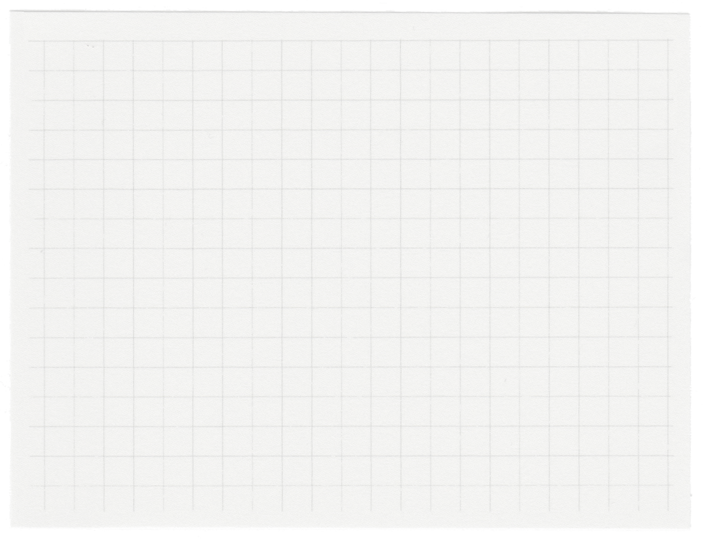
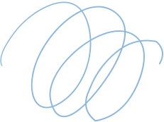


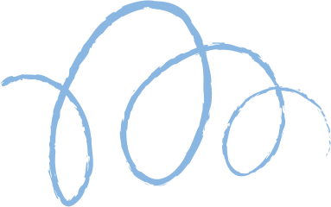









GAN Image Generation
Presented by Caleb p2341475 & Adam p2317425

Slide 2
Content
Data Exploration
Data Preprocessing
Model Building
Model Improvement
Model Evaluation
Conclusion

Slide 3
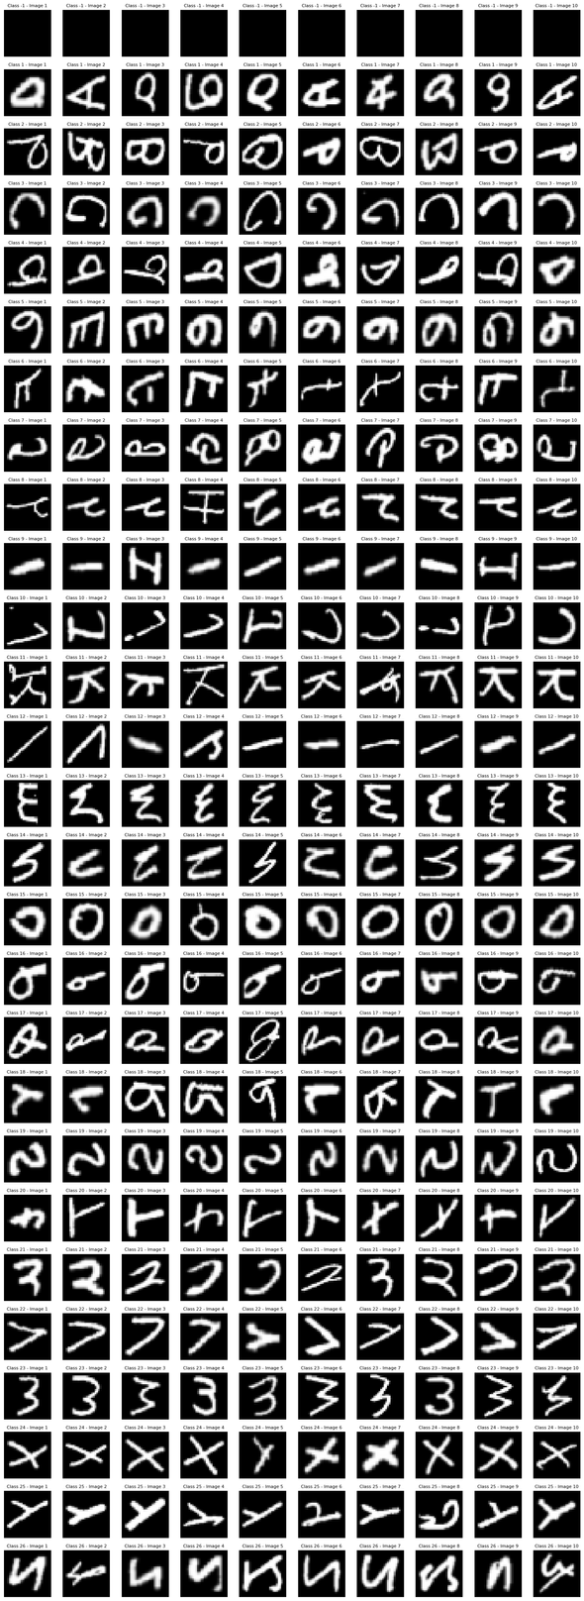
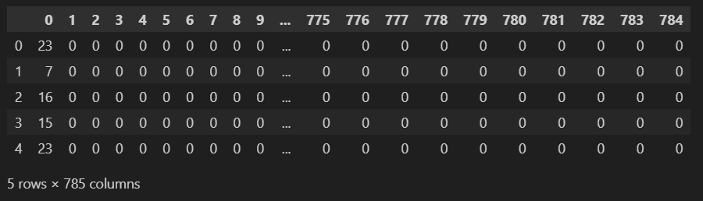
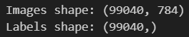
27 classes.
There is class -1 which is blank and does not contain any useful features or contribute to an alphabet for machine learning.
We can also observe that images are not in the correct orientation.
There is a mix of upper case and lower case letters as "a" and "A" look differently, affecting the ability of the machine to learn.
Data Exploration
785 columns and 5 rows in the dataset.
Each row represents a image. The 1st column represents the labels of each letter. The 2nd to 784th column represents the image data.
To store the images easily, the images are flattened from a 28x28 to a 784 vector where each column holds a part of the image

Slide 4
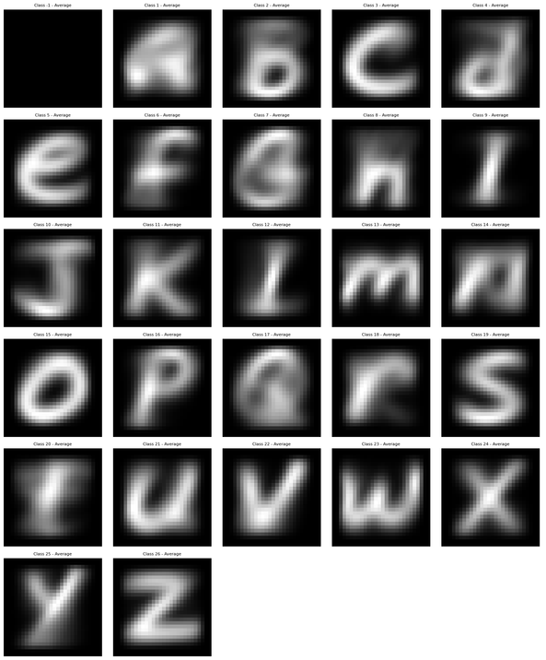
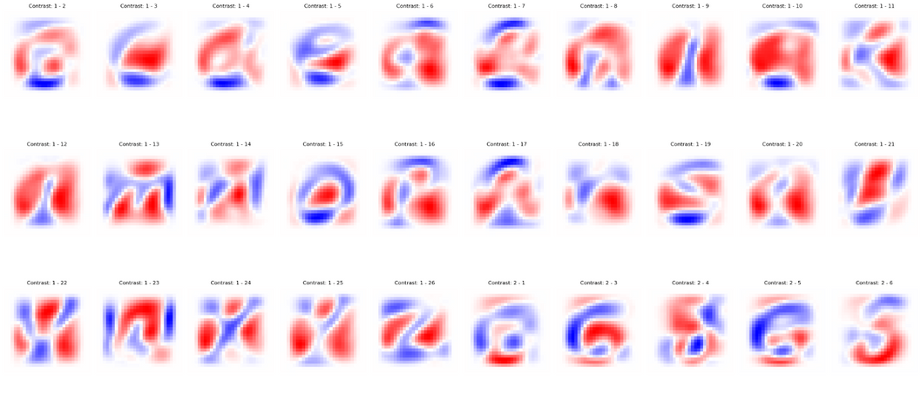
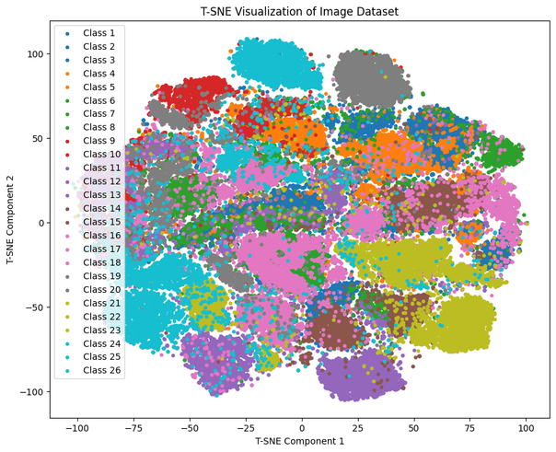
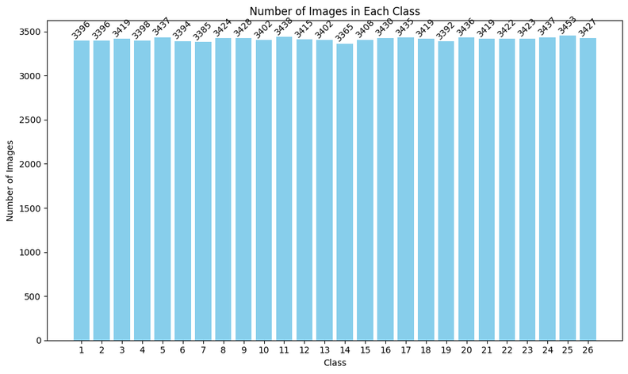
Constrative image on eg. class A to compare features between other classes more clearly
Finding Average Image to highlight the details among the classes
T-SNE helps us to visualize each class to see if there is much overlap which indicate similarities
Viewing the number of images in each class

Slide 5
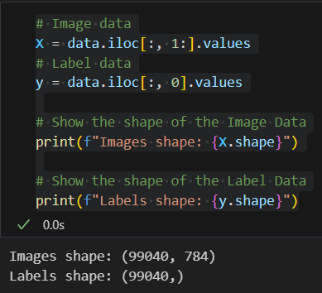
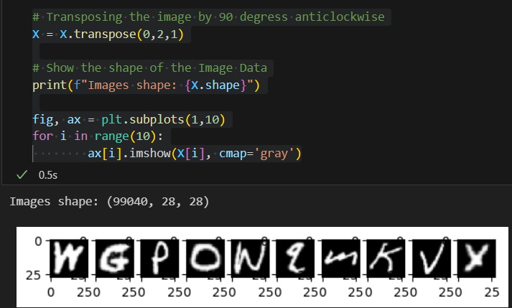
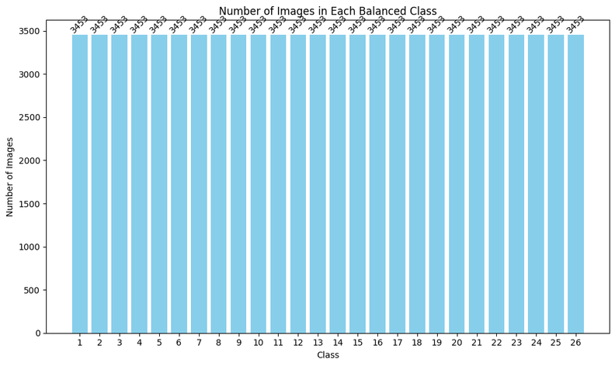
Data Preprocessing
Converting back to the 28x28 vector size
Transposing the images to change orientation
Making each class have the same number of images

Slide 6
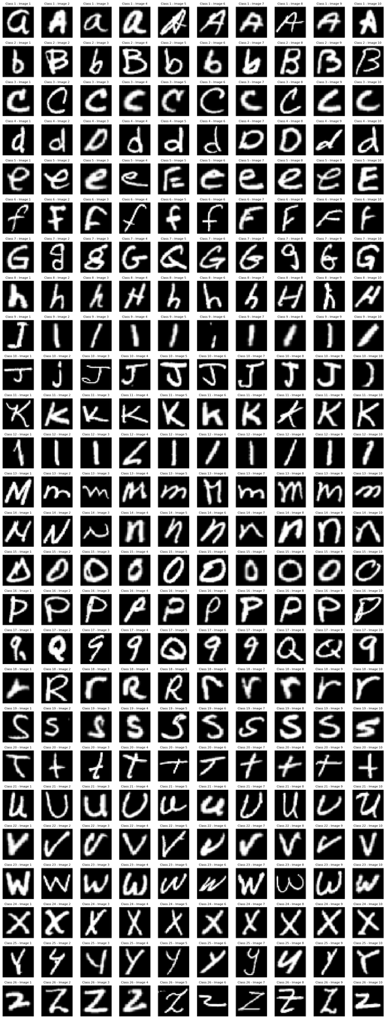
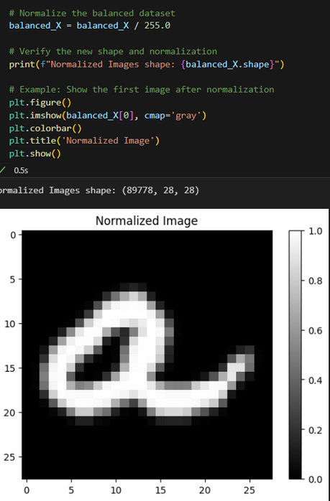
Dropping class -1 which was blank
Normalizing the images to stabilize training where each feature has equal opportunity to be trained

Slide 7
Model Building - DCGAN
Strengths | Weakness
Image Generation: DCGANs can generate high-quality images, which is beneficial if you want to generate more samples of handwritten characters or digits. | Lack of control over output DCGANs do not incorporate labels directly into the generation process so generating a specific class is not possible
High Resolution: DCGANs are capable of producing reasonably high-resolution images, which can be useful if you need detailed character images.
Training Stability: The architecture improvements of DCGANs, such as using batch normalization and ReLU activations, help stabilize training and improve convergence compared to other GAN models.

Slide 8
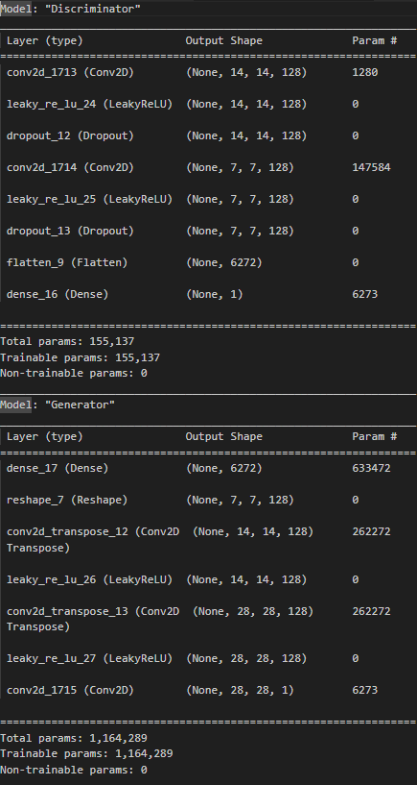
Model Building - DCGAN

Slide 9
Choice of Metrics
Discriminator Loss (D Loss):
Smaller values are generally better, indicating effective differentiation. However, if too small, the generator may need improvement.
Generator Loss (G Loss):
Smaller values are better, as they indicate that the generator is successfully creating realistic handwritten characters.
Discriminator Accuracy (D Accuracy):
Larger values are better, showing that the discriminator is effectively distinguishing between real and generated characters.
KL Divergence (Kullback-Leibler Divergence):
Smaller values are better, indicating that the generated characters’ distribution is close to the real characters’ distribution.
FID Score (Fréchet Inception Distance):
Smaller values are better, indicating that the generated handwritten characters are of higher quality and closely resemble real characters.

Slide 10
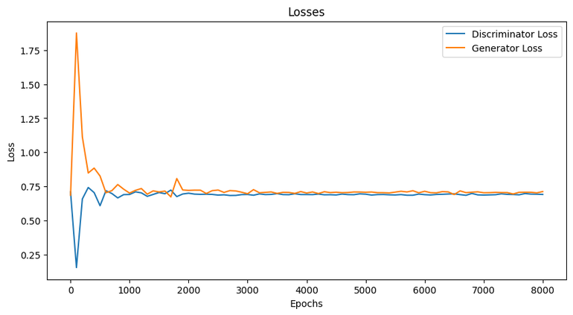
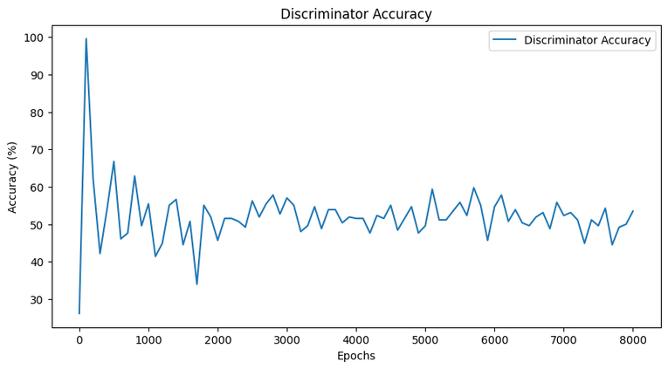
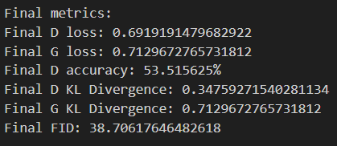
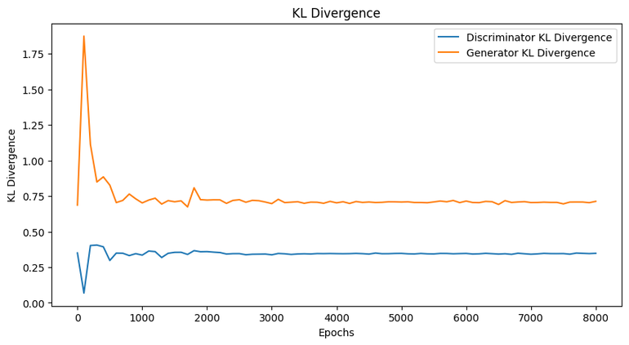
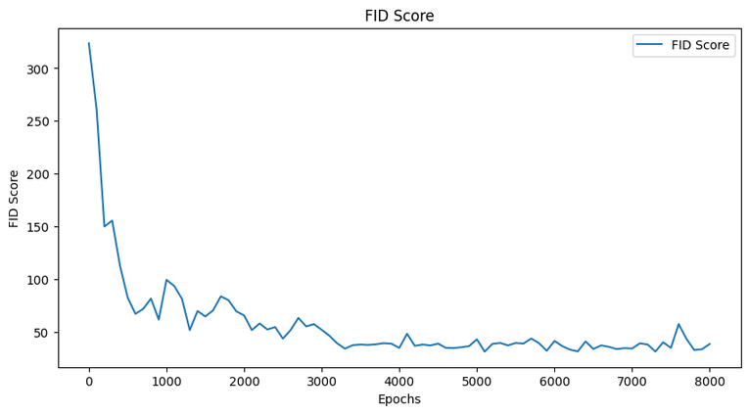
Model Evaluation - DCGAN

Slide 11
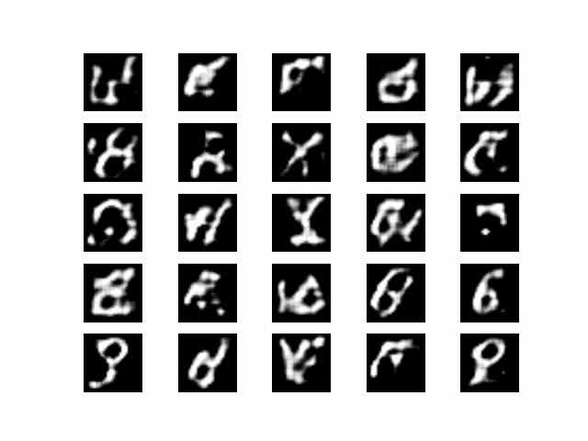
Model Evaluation - DCGAN

Slide 12
Model Building - CCGAN
Strengths | Weakness
Class-Conditional Generation: cGANs can generate images of specific classes within the EMNIST dataset (e.g., specific handwritten letters). This is useful if you need to generate samples of particular characters or digits. | Mode Collapse: cGANs are still susceptible to mode collapse, where the generator produces limited diversity in the output, even when conditioned on different labels.
Improved Quality and Relevance: By conditioning on additional information, cGANs can produce more relevant and higher-quality outputs compared to standard GANs. | Balancing Generator and Discriminator: Description: The conditioning information needs to be balanced carefully between the generator and discriminator to ensure effective learning.
Controlled Generation: cGANs allow for more controlled generation of data by conditioning the output on specific information. This is useful for generating data of particular classes or with particular attributes. | Complexity and Training Stability: Adding conditioning information increases the complexity of the model, which can make training even more challenging and unstable.

Slide 13
Model Building - CGAN

Slide 14
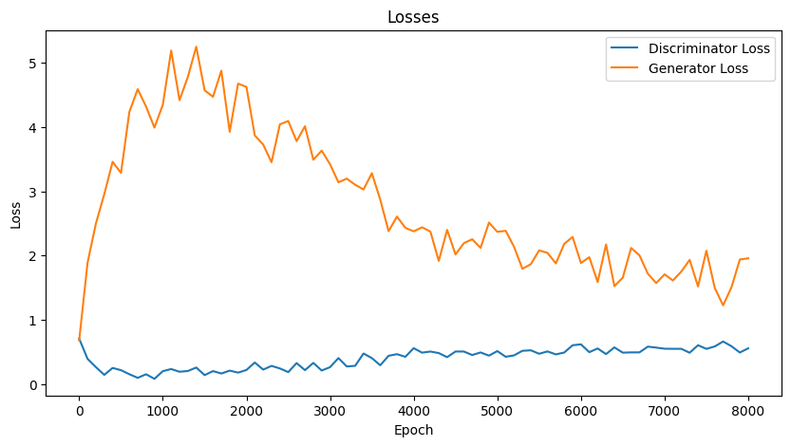
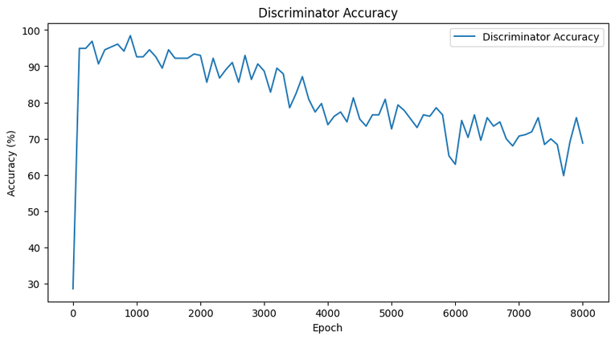
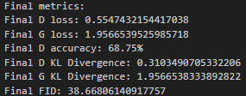
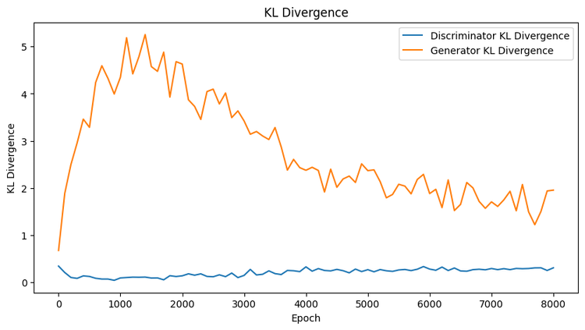
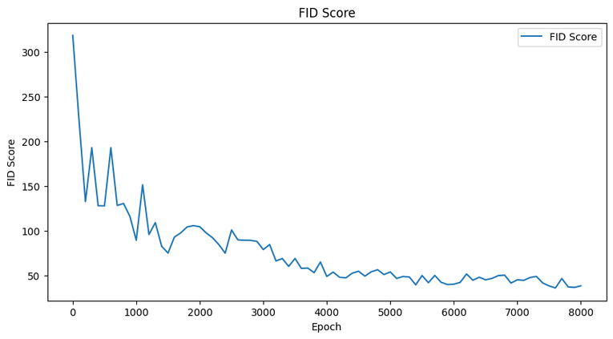
Model Evaluation - CGAN

Slide 15
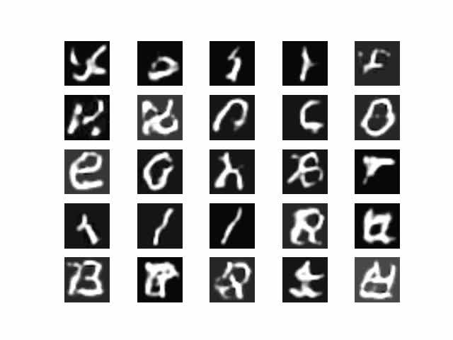
Model Evaluation - CGAN

Slide 16
Choice of Model Improvement
Label Smoothing:
Regularization technique used in machine learning to improve the training of GANs. It involves modifying the target labels to be less certain, which can help models generalize better and reduce overfitting.
For instance, instead of having a label of 1 for the true class and 0 for others, label smoothing might use 0.9 for the true class and 0.1 (or lower) for the others.
Feature Matching:
A technique used in GANs to stabilize the training process and improve the quality of generated samples. It helps in addressing some of the training challenges by modifying the loss function used for training the generator.
Spectral Normalization:
A technique used in the training of GANs to stabilize the training process by controlling the spectral norm (or largest singular value) of weight matrices in the network.
Addresses issues related to the training of GANs, such as instability and mode collapse, by ensuring that the network does not become too powerful.

Slide 17
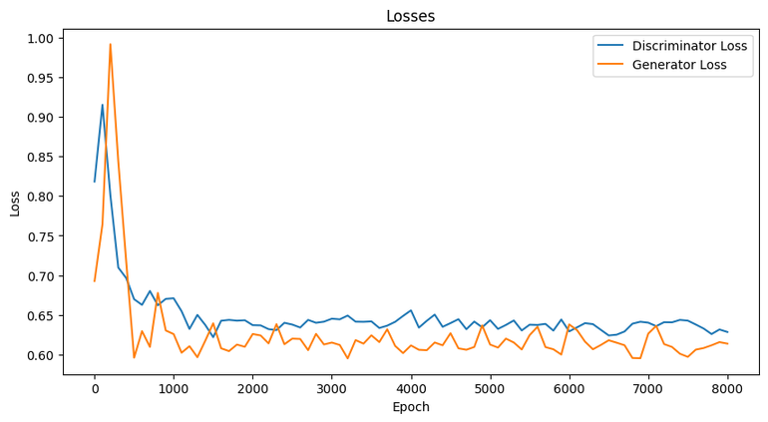
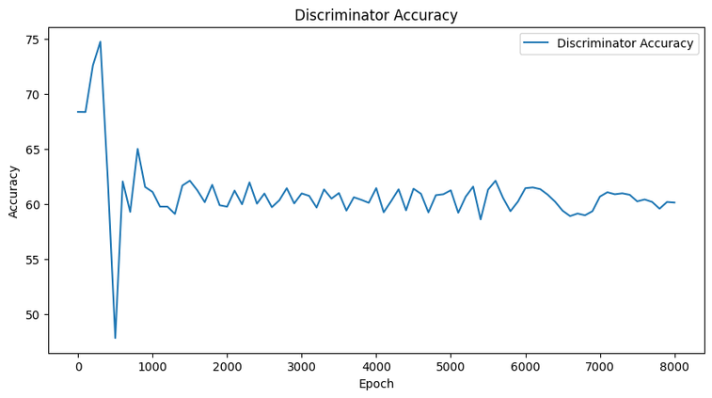
Model Evaluation - DCGAN Improved
Before:
After:

Slide 18
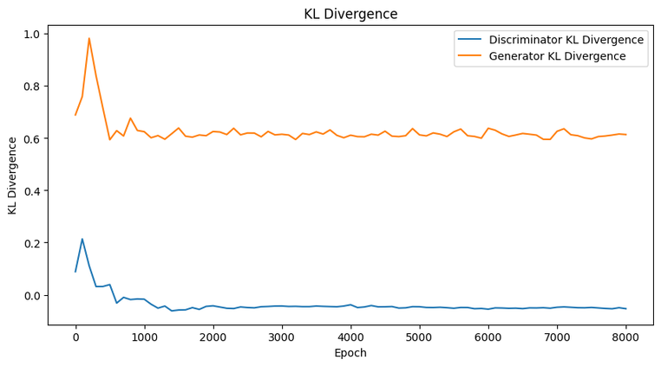
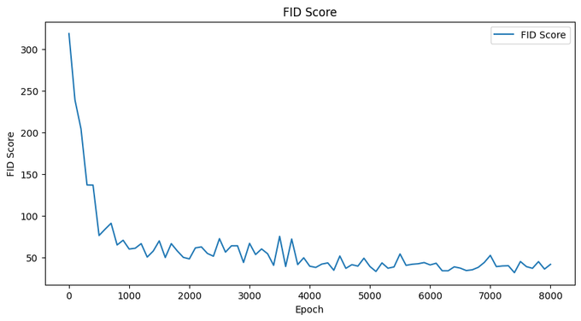
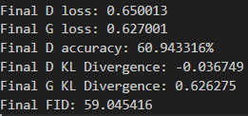
Model Evaluation - DCGAN Improved
Before:
After:

Slide 19
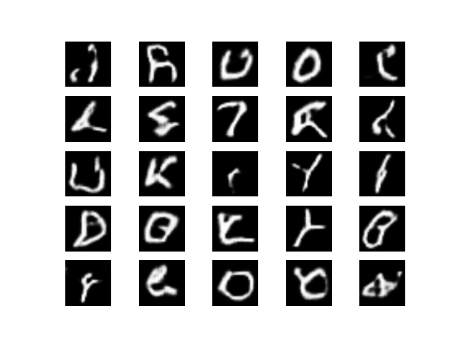
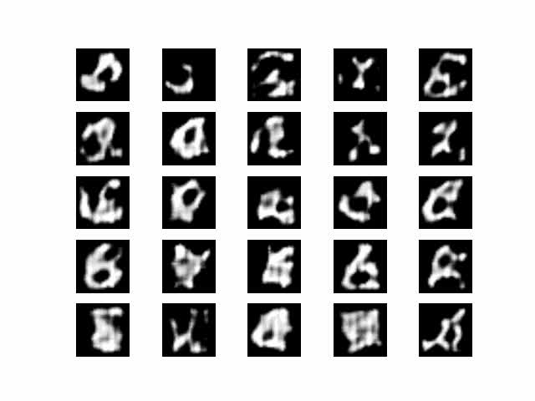
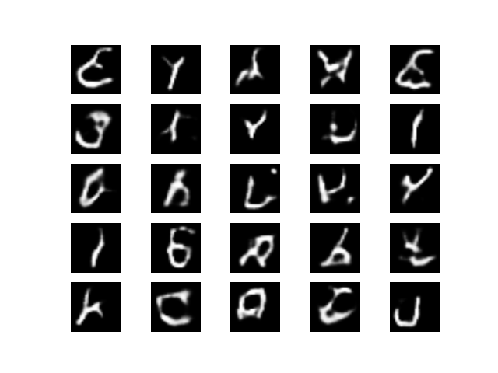
Model Evaluation - DCGAN Improved
Before:
After:

Slide 20
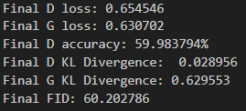
Model Evaluation - DCGAN Improved
Before:
After:
Discriminator Loss: The improved D loss of 0.6500 is lower than the base value of 0.6919, indicating that the discriminator is learning better at distinguishing between real and generated images.
Generator Loss: The improved G loss of 0.6270 is lower than the base value of 0.7130, suggesting that the generator is performing better at producing images that fool the discriminator.
Discriminator Accuracy: The increased D accuracy of 60.94% (up from 53.52%) shows that the discriminator is more accurate in its classification, which generally reflects an improved learning process.
Discriminator KL Divergence: The improved value of 0.0367 is unusual, as KL divergence is typically not so small. This might indicate an issue with numerical stability or computation.
Generator KL Divergence: The improved G KL divergence of 0.6263 (down from 0.7130) is better, showing that the generator's output is closer to the target distribution.
FID: The FID has increased from 38.71 to 59.05. An increase in FID suggests that the image quality or diversity of the generated images has decreased, which might be a result of changes in training dynamics or other factors.
The improved metrics show progress in some areas, particularly with reduced generator loss and improved discriminator accuracy. However, the increase in FID suggests that the overall quality of generated images may have worsened.

Slide 21
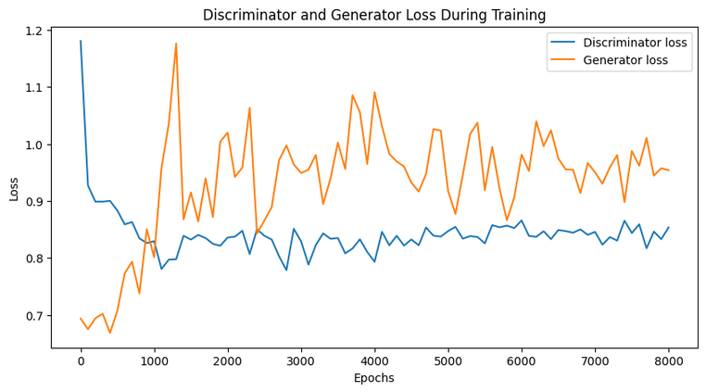
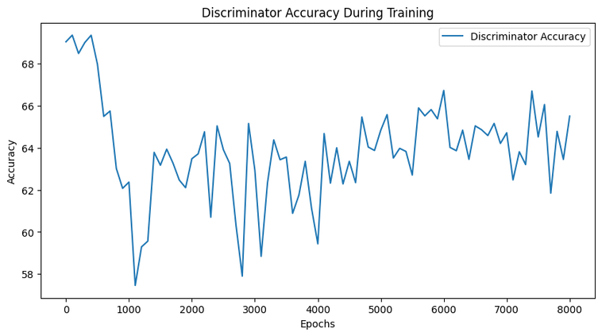
Model Evaluation - CGAN Improved
Before:
After:

Slide 22
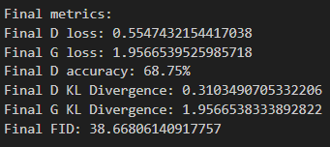
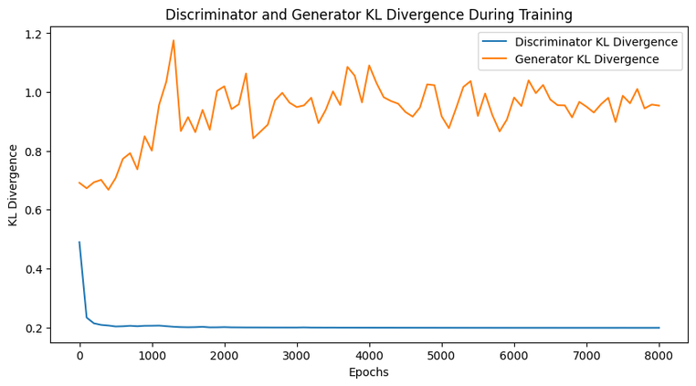
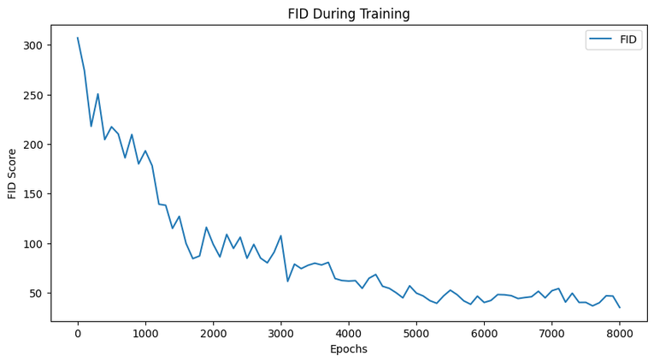
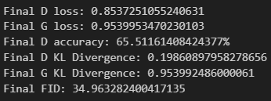
Model Evaluation - CGAN Improved
Before:
After:

Slide 23
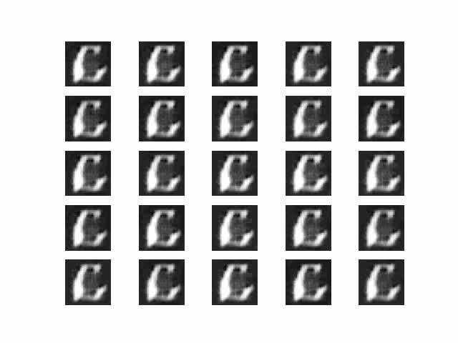
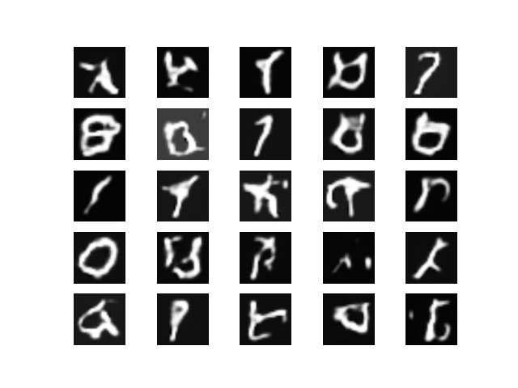
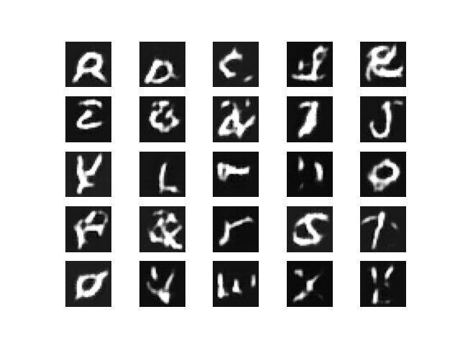
Model Evaluation - CGAN Improved
Before:
After:

Slide 24
Model Evaluation - CGAN Improved
Before:
After:
Discriminator Loss: The D loss has increased from 0.5547 to 0.8537. This increase suggests that the discriminator is finding it more challenging to distinguish between real and generated images after training, which could indicate that the generator's images are becoming more convincing.
Generator Loss: The G loss has significantly decreased from 1.9567 to 0.9540, showing a substantial improvement in the generator’s performance. The generator is now better at producing images that can fool the discriminator.
Discriminator Accuracy: The D accuracy has slightly decreased from 68.75% to 65.51%, which, in combination with the higher D loss, indicates that the discriminator is having a harder time distinguishing between real and generated images, implying improved performance of the generator.
Discriminator KL Divergence: The D KL divergence has decreased from 0.3103 to 0.1986, suggesting that the discriminator's learned distribution is closer to the true distribution of real images.
Generator KL Divergence: The G KL divergence has significantly decreased from 1.9567 to 0.9540, aligning with the generator loss, indicating that the generator's output distribution is much closer to the target distribution.
FID (Fréchet Inception Distance): The FID has decreased from 38.67 to 34.96, showing an improvement in the quality and diversity of the generated images. Lower FID scores are better, and this decrease indicates that the images produced by the generator are closer to real images.
There is a noticeable improvement in the generator's performance, as evidenced by the reduced G loss, G KL divergence, and FID. Although the discriminator loss and accuracy have worsened, this is often expected as the generator improves. The overall improvements in the generator’s performance and the quality of the generated images are reflected in the lowered FID score. This indicates that my training process is effective in enhancing the generator's ability to produce realistic images.

Slide 25
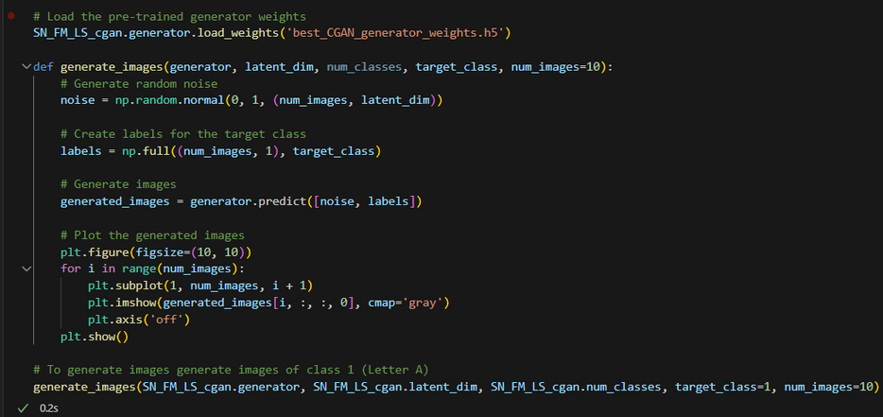
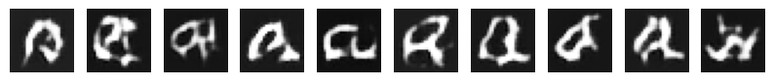
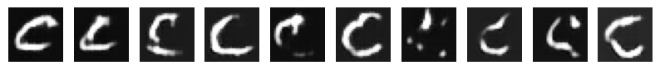
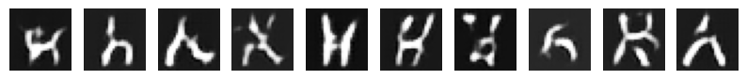

Generation Of Images
Generate a specific class:
Class 1 (A):
Class 3 (C):
Class 8 (H):
You can choose which character to generate by changing the target class. For instance, target class 1 is “A”, 1st letter of the ABCs.
Class 15(0):

Slide 26


Generation Of Images
Generate 10 images from each class:

Slide 27

Generation Of Images
Generate 10 images from each class:

Slide 28
Conclusion
Our CGAN Improved is the best model that we can use to generate images due to its ability to take in labels, and the fact that generator's performance is better, as evidenced by the reduced G loss, G KL divergence, and FID. This also indicates that the model is effective in producing realistic images.

Slide 29
Conclude - Ans to Qns from brief
What class(es) is/are relatively easier/harder to generate? Why?
Classes that are harder to generate are those with similar looking characters or cause of the variablity of the writing styles.
In this case for the EMNIST dataset after we have generated for every class:
Similar looking characters
Characters that are more similar in shape and structure (e.g. E & F, R & K) can be harder to generate accurately because the model needs to capture subtle distinctions. Furthermore, the EMNIST dataset contains both lower and upper case characters. This makes it even harder due to characters such as (e.g. lower case l and upper case I or lower case i) looking alike, or characters that are totally different from their lower case or upper case counterparts (e.g. D,d and E,e and R,r and G,g)
Variations in handwriting styles
Differences in stroke thickness or character slant, can introduce additional complexity. People have different handwritings and writing styles. Characters such as lower case letter a has multiple ways that can be written.
Classes that are easier to generate are those with distinct letters and consistent writing styles
Distinct letters
Characters with more distinctive shapes might be easier to generate because they have clearer structural patterns. (e.g., 'A', 'Q')
Consistent writing styles
Characters that are more uniform in style and structure within the dataset will be easier for the model to learn and generate. Some examples are V,v and Z,z and X,x.

Slide 30
Conclude - Ans to Qns from brief
If you are asked to generate coloured images instead of black-and-white ones, do you think it would be easier or harder to produce better quality results?
Colored images would be harder to generate and produce better results than black-and-white images.
Increased complexity
Data Dimensions: Colored images have three channels (RGB), whereas black-and-white images have just one channel. This means the generator and discriminator networks need to handle more complex data, which requires more capacity and potentially more training data.
Higher variability
Color Variations: Colors add an additional layer of variability and complexity in how patterns and textures are represented. For instance, a slight change in color can drastically alter the perceived quality of an image.
Training stability
Training Dynamics: With more complex data, the training dynamics of GANs can become more unstable. Generating colored images might require more careful tuning of hyperparameters and network architectures.
In this case for the EMNIST dataset:
EMNIST images are grayscale by default. Converting them to color (e.g., using RGB channels) would introduce complexity because you would need to generate color variations that make sense for handwritten characters. This might not add significant value because the natural color of handwritten letters is grayscale.
The model complexity will increase as it needs to handle three color channels instead of one. This requires more sophisticated network architectures and potentially more training data.

Slide 31
Reinforcement Learning

Slide 32
Content
Background research, explanations of approach(es) taken
Application of RL with appropriate rationale and explanations
Evaluation of DQN RL and Improvements
Evaluation of PPO RL and Improvements
Conclusion

Slide 33
Background Research - Pendulum Environment
The inverted pendulum swingup problem is based on the classic problem in control theory. The system consists of a pendulum attached at one end to a fixed point, and the other end being free. The pendulum starts in a random position and the goal is to apply torque on the free end to swing it into an upright position, with its center of gravity right above the fixed point.
Action Space
The action is a ndarray with shape (1,) representing the torque applied to free end of the pendulum.
Num Action Min Max
0 Torque -2.0 2.0
This Pendulum Environment is a Continuous Action Space: The action can take any real value within the specified range, which in this case is from -2.0 to 2.0. This means the agent can apply any torque value within this range.
Reinforcement Learning (RL) is a type of machine learning where an agent learns to make decisions by performing actions in an environment to maximize cumulative rewards. Key concepts include:
Agent: The learner or decision maker.
Environment: Everything the agent interacts with.
State: A representation of the environment at a given time.
Action: Choices available to the agent.
Reward: Feedback from the environment in response to an action.

Slide 34
Application of RL with appropriate rationale and explanations
This Environment is a continuous action space, but upon our own research, DQN is better suited for discrete action spaces.
Discrete Action Spaces:
Action Selection: DQN selects actions by evaluating the Q-values for each possible action and choosing the action with the highest Q-value. This works well when the number of actions is finite and discrete.
Action Representation: The output layer of a DQN typically has a node for each possible action, making it easy to handle discrete actions.
Continuous Action Spaces:
Challenges: In continuous action spaces, the action space is infinite and continuous, making it impractical to directly apply the same Q-value evaluation strategy as in discrete spaces.
Alternatives: For continuous action spaces, alternative algorithms like DDPG (Deep Deterministic Policy Gradient), TD3 (Twin Delayed DDPG), and PPO (Proximal Policy Optimization) are often used. These methods can handle continuous actions by directly parameterizing the policy or using actor-critic methods.

Slide 35
Explanation of approaches taken
Deep Q-Networks (DQN): A deep learning approach for RL where Q-values (action-values) are approximated using neural networks. Key innovations:
Experience Replay: Stores past experiences to break correlation and stabilize training.
Target Network: A separate network for calculating target Q-values, improving stability.
Improved DQN:
Epsilon Decay: gradually reduces the value of epsilon over time, making the agent explore less and exploit more as it learns. This helps the agent to initially discover promising actions and then focus on refining its strategy.
Adaptive Learning Rate: Adjusts the learning rate dynamically based on training progress.
Reward Normalization: To stabilize the learning process by rescaling the rewards which ensures that they have a consistent scale, which can improve the convergence of the learning algorithm

Slide 36


Baseline DQN Agent evaluation
the DQN agent shows signs of stable learning with a concentration of Q-values near zero, but the variability in the Q-values suggests that the learning process is not fully stable yet.
There are significant fluctuations in the rewards throughout the episodes. This variability suggests that the agent’s performance is inconsistent, with episodes of both high and low rewards. while the DQN agent shows improvement and some stabilization, the learning process still exhibits variability. This indicates that the agent’s learning is not entirely stable yet, and further training or tuning of hyperparameters might be necessary to achieve more consistent performance.
The highest frequency of Q-values is near zero, indicating that the agent frequently predicts Q-values close to zero. This could suggest that many actions taken by the agent result in similar expected rewards. The DQN agent shows signs of stable learning with a concentration of Q-values near zero, but the variability in the Q-values suggests that the learning process is not fully stable yet.

Slide 37


Baseline DQN Agent evaluation
Stability Concerns: The sharp fluctuations and the eventual decline in the moving average reward suggest that the learning process is not stable. The agent shows periods of improvement but fails to sustain them.
In summary, while the DQN agent shows periods of improvement, the overall learning process is unstable, as evidenced by the sharp decline in performance towards the end
The learning speed, represented by the reward difference between episodes, fluctuates significantly throughout the training process. There are sharp spikes both upwards and downwards, indicating periods of rapid learning and periods of regression. The significant fluctuations in learning speed throughout the episodes indicate that the DQN agent’s learning process is not stable.

Slide 38


Improved DQN Agent evaluation
The concentration of Q-values at the lower end indicates that the agent frequently predicts similar, lower expected rewards. This consistency can be seen as a sign of stability, as the agent has learned a predictable pattern. The skew towards lower Q-values might mean the agent has adopted a conservative policy, focusing on actions that yield lower but more certain rewards.
The fact that the rewards stay within a relatively narrow range suggests that the agent has learned a policy that avoids extreme failures (very low rewards) and achieves a moderate level of success. the agent’s performance shows a degree of stability, which is a positive sign.

Slide 39


Improved DQN Agent evaluation
The upward trend in the moving average reward suggests that the agent is learning and improving its policy over time, which is a positive sign of stability. he sharp decline towards the end of the graph indicates a significant drop in performance. This suggests that the agent’s learning process is not entirely stable, as it fails to maintain the improved performance consistently.
The reward differences are within a moderate range, indicating that the agent’s learning speed is not experiencing extreme volatility. This can be seen as a positive sign of some level of stability.
While there are fluctuations, the fact that they are not excessively large suggests that the agent is maintaining a certain level of performance without drastic changes.

Slide 40

Improved DQN Agent evaluation
This is the last 50 episode of training of the pendulum env

Slide 41
Explanation of approaches taken
Proximal Policy Optimization (PPO): PPO optimizes policies using neural networks and ensures stable updates by employing a clipped objective function, which helps maintain reliable and consistent improvements.
Improved PPO:
Epsilon Decay: Gradually reduces the exploration rate, allowing the agent to explore diverse actions initially and then focus on refining its strategy as it learns more about the environment.
Adaptive Learning Rate: Dynamically adjusts the learning rate based on training progress, ensuring efficient and stable learning throughout the training process.
Reward Normalization: Standardizes rewards to a consistent scale, which helps in stabilizing the learning process and improving convergence by preventing issues with varying reward magnitudes.

Slide 42


Baseline PPO Agent evaluation
There are significant fluctuations in the rewards throughout the episodes. This variability suggests that the agent’s performance is inconsistent, with episodes of both high and low rewards.
e in the rewards suggest that the learning process is not entirely stable. The agent shows periods of improvement but fails to sustain them consistently.
In summary, while the PPO agent shows periods of improvement, the overall learning process is unstable, as evidenced by the significant fluctuations in performance.
The histogram shows that higher Q-values (closer to 0) are more frequent, indicating that the PPO agent often predicts higher expected rewards for its actions.
The concentration of Q-values towards the higher end (closer to 0) suggests that the agent has learned a policy that often results in higher expected rewards. This can be seen as a sign of stability, as the agent consistently predicts higher rewards for its actions.
Overall, the histogram indicates that the PPO agent’s learning process is relatively stable, with a tendency to predict higher Q-values.

Slide 43


Baseline PPO Agent evaluation
: The learning speed, represented by the reward difference between episodes, fluctuates significantly throughout the training process. There are sharp spikes both upwards and downwards, indicating periods of rapid learning and periods of regression.The variability in learning speed indicates that the agent’s performance is not consistently improving. This inconsistency can be a sign of instability in the learning process.
Despite the upward trend, the fluctuations indicate that the learning process is not entirely stable. The agent shows periods of improvement but also experiences declines, suggesting some instability in the learning process.
Overall, while the PPO agent shows improvement during the training process, the fluctuations indicate that the learning process is not fully stable.

Slide 44


Improved PPO Agent evaluation
The lack of a clear trend towards improvement or decline indicates that the learning process is not entirely stable. The agent shows periods of improvement but also experiences declines, suggesting some instability in the learning process.
Overall, while the improved PPO agent shows some stability due to the moderate range of fluctuations, the significant variability suggests that further tuning or adjustments might be necessary to achieve more consistent and stable learning.
The concentration of Q-values towards the higher end (closer to 0.12) suggests that the agent has learned a policy that often results in higher expected rewards. This can be seen as a sign of stability, as the agent consistently predicts higher rewards for its actions.
Overall, the histogram indicates that the improved PPO agent’s learning process is relatively stable, with a tendency to predict higher Q-values

Slide 45


Improved PPO Agent evaluation
The variability in learning speed indicates that the agent’s performance is not consistently improving. This inconsistency can be a sign of instability in the learning process. Overall, the learning process shows some stability due to the moderate range of fluctuations, but the significant variability suggests that further tuning or adjustments might be necessary to achieve more consistent and stable learning.
Despite the upward trend, the fluctuations indicate that the learning process is not entirely stable. The agent shows periods of improvement but also experiences declines, suggesting some instability in the learning process.
Overall, while the PPO agent shows improvement during the training process, the fluctuations indicate that the learning process is not fully stable.

Slide 46

Improved PPO Agent evaluation
This is the last 50 episode of training of the pendulum env

Slide 47
Conclusion
We can see that for DQN , it is more stable when it is improved and for PPO when it is improved , it only became a little bit more stable but it is not that significant of a change which means that PPO may not be that suitable for this specific environment.

Slide 48
Answering qns from brief
Is one trial enough or should you
repeat the trials? Why?
Consistent Physics: The Pendulum environment follows deterministic physics, meaning that the behavior of the pendulum is governed by a fixed set of equations without random variations. Given the same initial conditions and actions, the pendulum will always behave in the same way.
Predictable Responses: Because the environment's response to actions is predictable, you can expect consistent results from the model's interactions with the environment.
Initial State Variation: The main source of randomness in the Pendulum environment is the initial state, which is randomly chosen within a specific range. However, once the episode starts, the pendulum's behavior is entirely deterministic.
How do you conclusively demonstrate your so-called “best setup” to be the best?
We considered Stable learning as by prioritizing stability, you ensure that the model's learning process is reliable and predictable, which is critical for practical applications. It provides confidence in the model's ability to perform consistently and generalize well, leading to more trustworthy and robust solutions.

Slide 49
Thank you very much!

